Slide 1
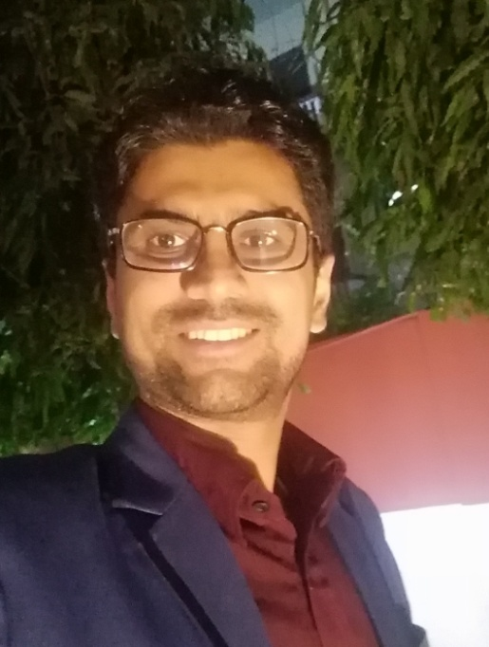
Mohan Bhandari
Physics Teacher/ Science Teacher , Janak Model Secondary School, Gaindakot
Email: bhandarimohan1989@gmail.com

Slide 2
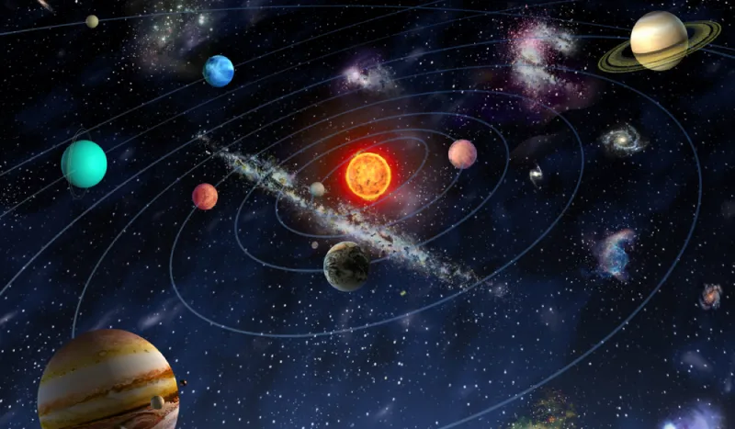
The Solar system and the universe

